Slide 1

Basics of Neural Network Programming
Broadcasting in
Python
deeplearning.ai
Notes:
Broadcasting is a technique to make code run faster.

Slide 2
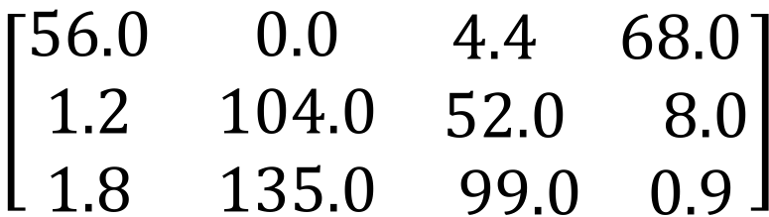
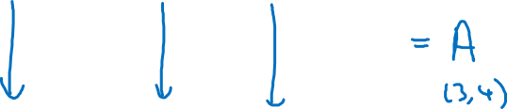
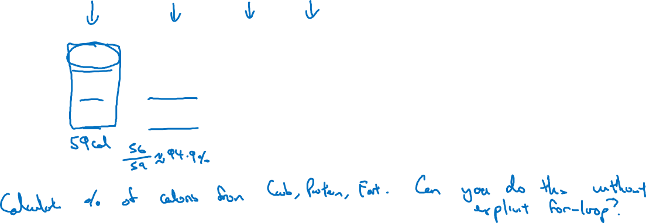
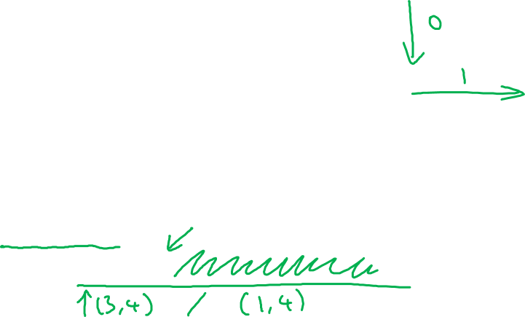
Broadcasting example
Calories from Carbs, Proteins, Fats in 100g of different foods:
Apples
Beef
Eggs
Potatoes
Carb
$$\left[\begin{matrix}56.0 & 0.0 & \begin{matrix}4.4 & 68.0\end{matrix} \\ 1.2 & 104.0 & \begin{matrix}52.0 & 8.0\end{matrix} \\ 1.8 & 135.0 & \begin{matrix}99.0 & 0.9\end{matrix}\end{matrix}\right]$$
Protein
Fat
cal = A.sum(axis = 0)
percentage = 100*A/(cal.reshape(1,4))
Notes:
Goal is to calculate percentage of calories for carb, protein & fat for different foods in the columns.
For apple, 59 is the total calories having carbs as 94.9
Where as in beef we have most calories from fat & proteins
Now in each case, what we are doing is that we are summing up column wise to get the total calories and then dividing each category calories onto the total to get the percentage.
Question: Can we do this without explicit for loop ?
Answer: We can set this matrix as A, with one line of python code we can sum the columns as 4 columns, in a second line of code we can divide the columns with the respective sum,

Slide 3
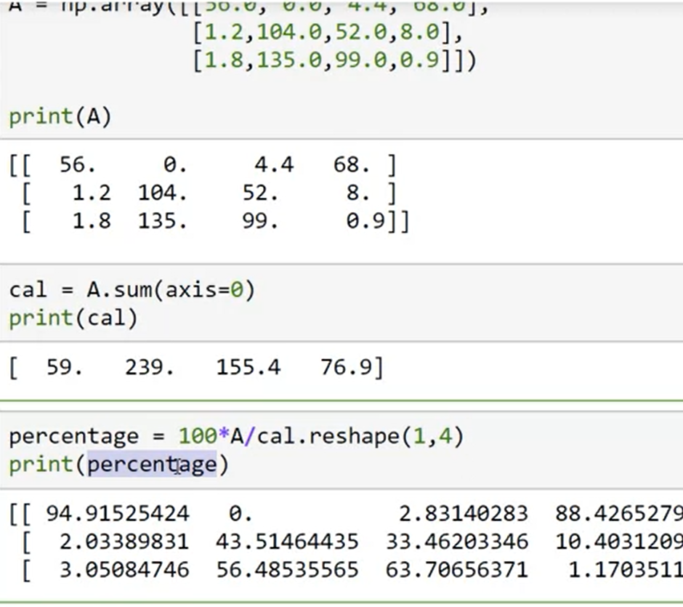
Broadcasting example
Axis = 0 column wise.
Reshape is an example of broadcasting where we divided a 3 by 4 matrix onto a 1 by 4 matrix.
We don’t really need to use the reshape here because python does that for us but for readability it is a good practice to do so.
Use reshape command.

Slide 4
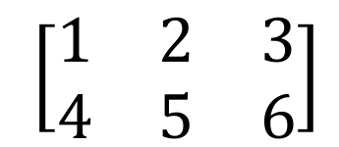
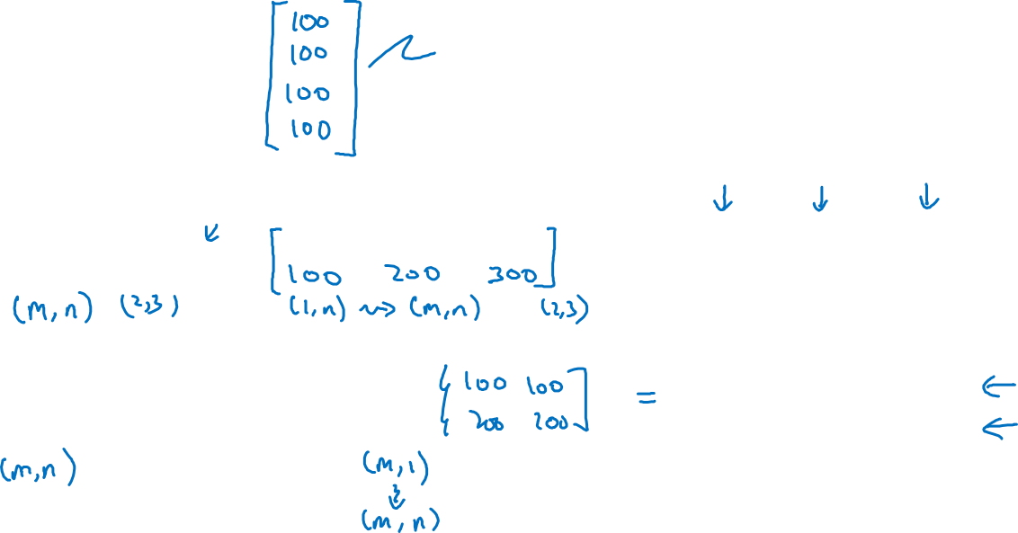
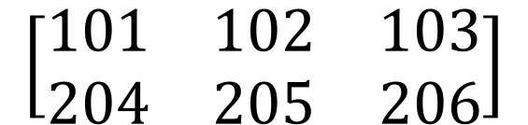

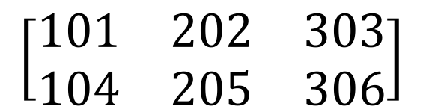

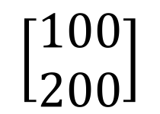

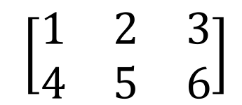
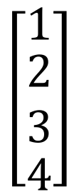
Broadcasting example
$$\left[\begin{matrix}1 \\ \begin{aligned}\begin{matrix}2 \\ 3\end{matrix} \\ 4\end{aligned}\end{matrix}\right]$$
$$\left[\begin{matrix}101 \\ \begin{aligned}\begin{matrix}102 \\ 103\end{matrix} \\ 104\end{aligned}\end{matrix}\right]$$
$$100$$
=
+
$\left[\begin{matrix}1 & 2 & 3 \\ 4 & 5 & 6\end{matrix}\right]$
$$\left[\begin{matrix}100 & 200 & 300\end{matrix}\right]$$
$$\left[\begin{matrix}101 & 202 & 303 \\ 104 & 205 & 306\end{matrix}\right]$$
+
=
$\left[\begin{matrix}1 & 2 & 3 \\ 4 & 5 & 6\end{matrix}\right]$
$$\left[\begin{matrix}100 \\ 200\end{matrix}\right]$$
$$\left[\begin{matrix}101 & 102 & 103 \\ 204 & 205 & 206\end{matrix}\right]$$
+
=
Notes:
Here we try to understand how did we divide a ¾ matrix onto a ¼ matrix or a vector.
Here we arte trying to add a number to a vector, what python does is that it creates a vector of the same shape to add element wise.
In 2nd example, 2,3 matrix is being added a 1 by 3 matrix, or generally speaking ist matrix is m by n & the second matrix is 1, n
What python will do is that it will copy the matrix m times by broadcasting.
Broadcasting works both vertically & horizontally.

Slide 5
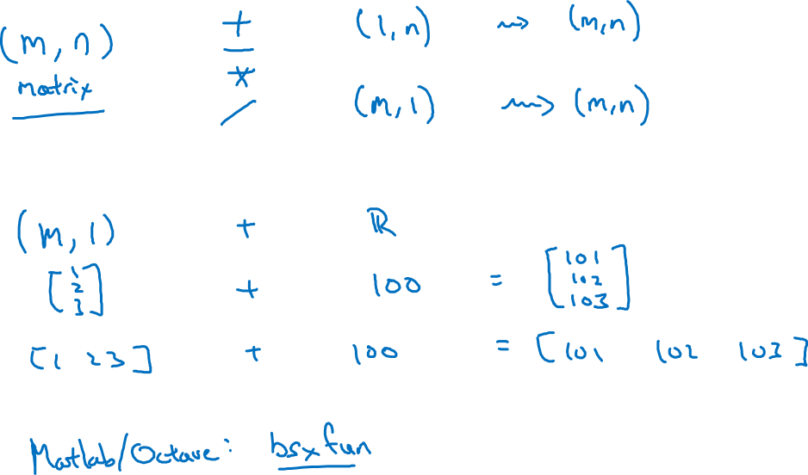
General Principle
Notes:
if we have m by n matrix & if we add, subtract, mul, div, a 1 by n matrix than python will add rows so that it becomes a m by n matrix & than apply element wise application.
Read broadcasting doc in numpy.

